Slide 1



Taxi Fare Forecasting Using Machine Learning and Big Data Technologies.

Slide 2
Group No.10 Monika Banothe (250243025007) Pranita Khollam(250243025017) Nidhi Naithani (250243025021) REETU Mishra (250243025027) Guided By: Milind Kapse sir

Slide 3

ABOUT OUR
GOAL
This project focuses on predicting taxi fares in New York City using historical data from 2020. By employing machine learning techniques, we seek to enhance the accuracy of fare estimates and analyze key factors that influence pricing
DATA
The dataset contains essential trip details such as pickup/drop-off locations, trip distance, passenger count, and payment information.

Slide 4
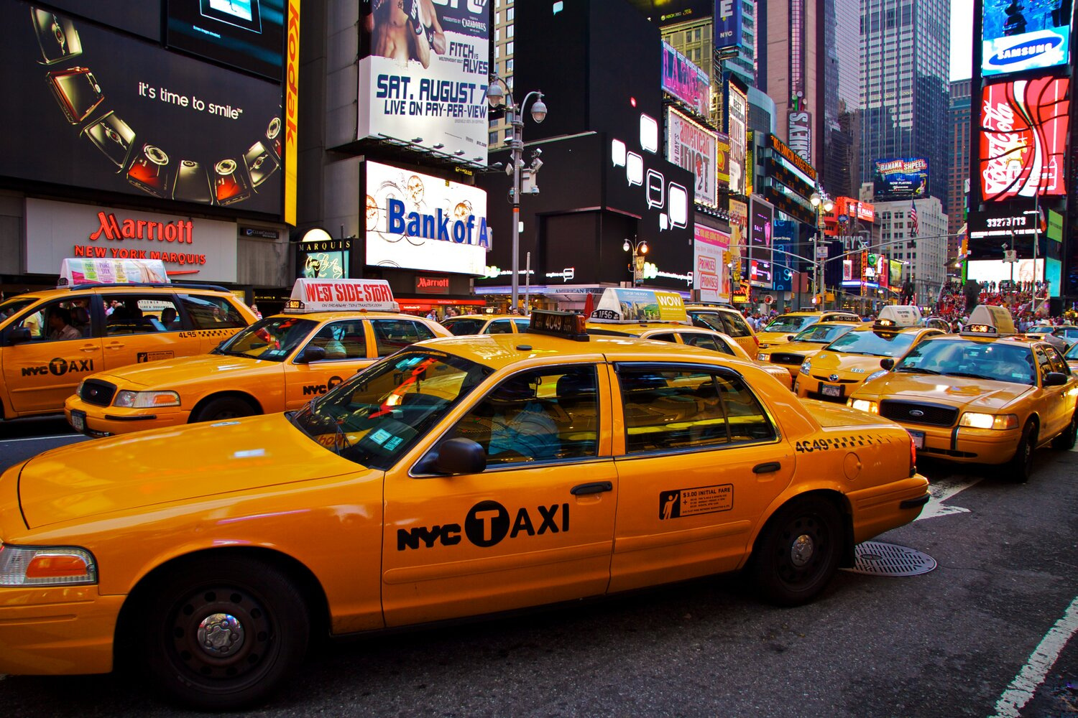




WORKFLOW
Data collection
Data Pre-Processing
Data Modelling
Data Visualization
Deployment

Slide 5

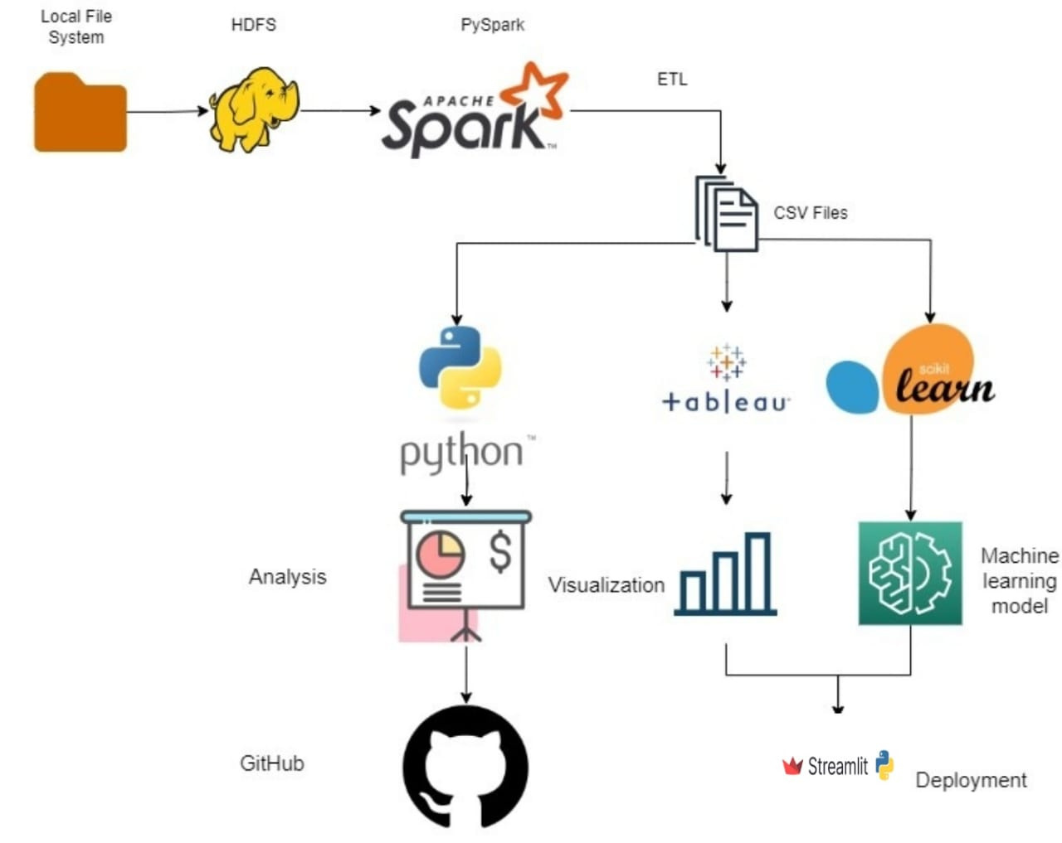
DATA
PIPELINE
&
MACHINE LEARNING ARCHITECTURE

Slide 6
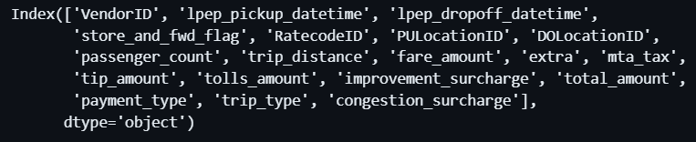
Data Collection
Data is taken from Kaggle.
Dataset contains following fields :

Slide 7


DATA PREPROCESSING
Hadoop:
Put data on HDFS.
On PySpark:
Hive table creation
Drop nulls and columns
Drop Negative values
Feature Engineering: Creating time category
Encoding time category
Preprocessed data file:
Loading the clean preprocessed data for further analysis into google drive.

Slide 8


DATA MODELLING
XGBoost
XGBoost (Extreme Gradient Boosting) is a popular and efficient gradient boosting algorithm. It is very fast and accurate.
KNN
KNN is a supervised machine learning model that makes predictions based on the K number of closest neighbours.
GradientBoostingRegression
Gradient Boosting Regression is a powerful ensemble machine learning technique used for regression tasks. It builds a strong predictor by combining many weak models (usually decision trees), each one correcting the errors of the previous one.

Slide 9
DATA MODELLING
CatBoost
CatBoost is a high-performance, open-source gradient boosting algorithm. It excels in handling datasets with categorical features and is used for classification, regression, and ranking tasks. CatBoost is known for its accuracy, speed, and robustness.
LightGBM
LightGBM (Light Gradient Boosting Machine) is another gradient boosting framework, known for its speed and efficiency. It uses tree-based learning algorithms and supports parallel and GPU learning.
Decision Tree
Decision tree is a supervised learning algorithm used for both classification and regression tasks. It has a hierarchical tree structure which consists of a root node, branches, internal nodes and leaf nodes.

Slide 10
MODEL ANALYSIS

Slide 11
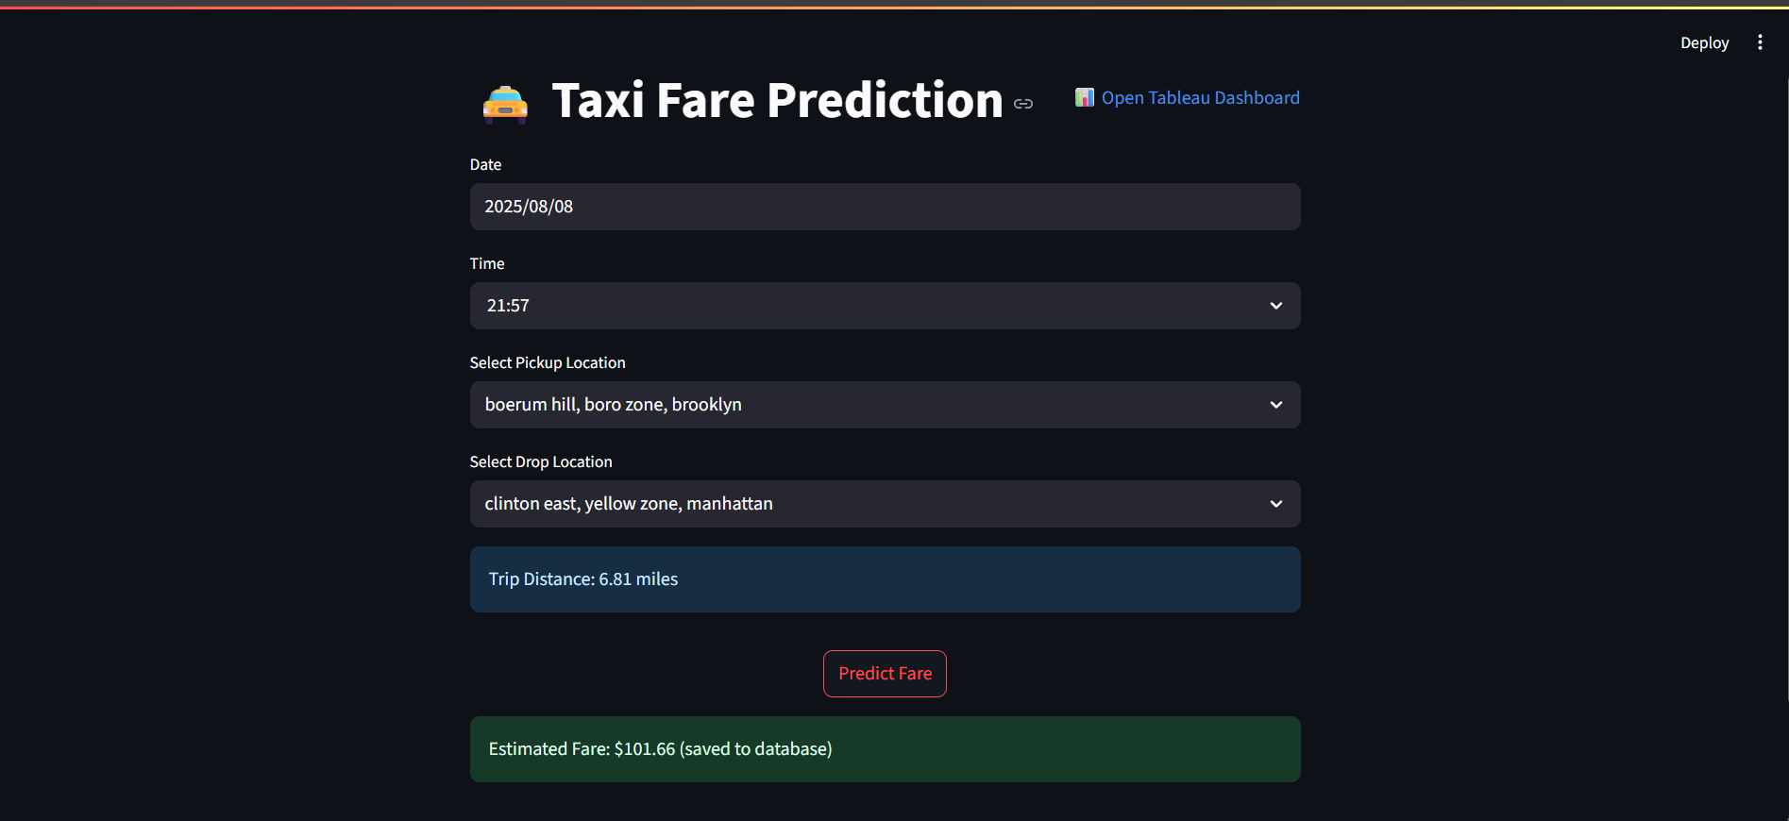
USER INTERFACE
Streamlit is an open-source Python library that makes it easy to create and share custom web apps for machine learning and data science.
By using Streamlit you can quickly build and deploy powerful data applications.

Slide 12
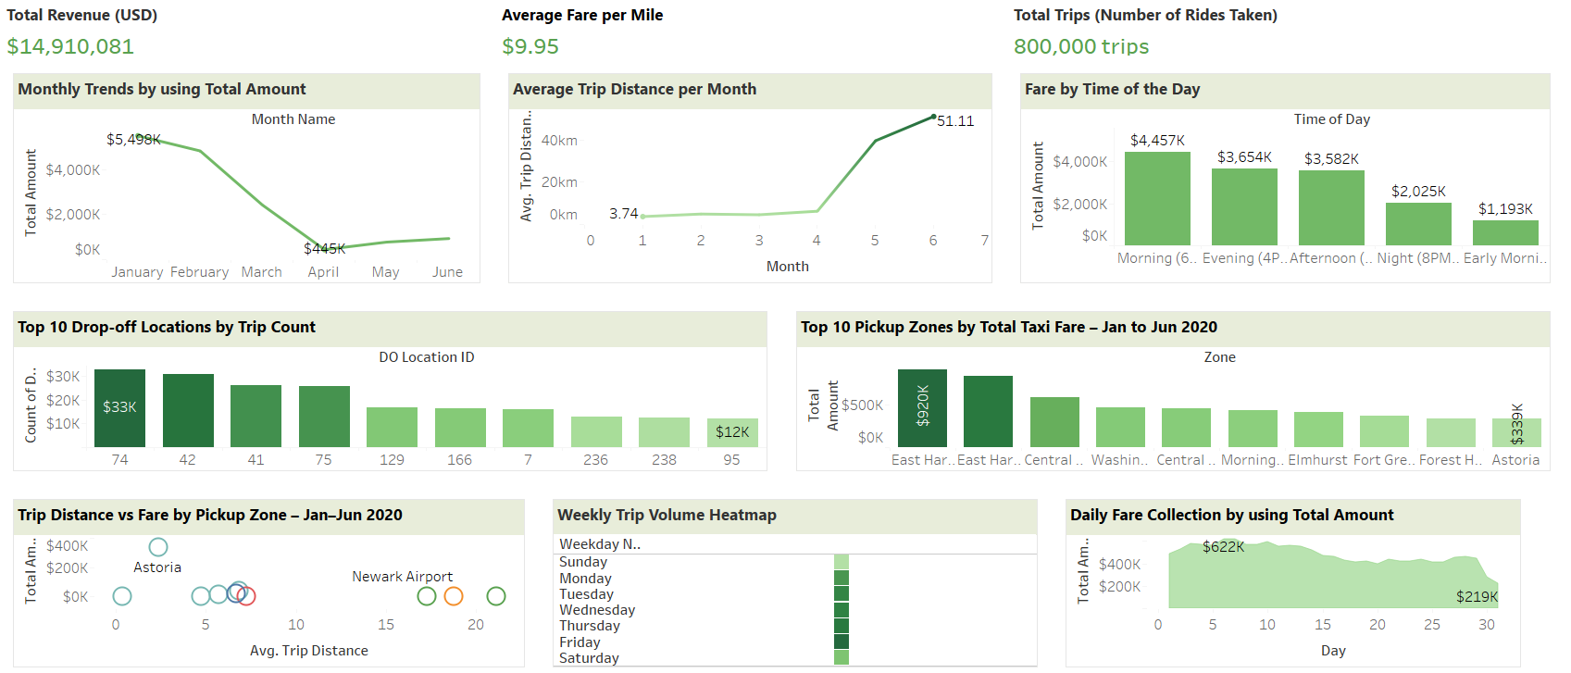
TABLEAU DASHBOARD

Slide 13

Important Links
Github Link:
- https://github.com/Reetu-Mishra/Taxi_Fare_Prediction
Google Drive Link:
- https://drive.google.com/drive/folders/1rgwoe4LgdkhxyrRS6RCluk8ITNcssGLv

Slide 14

THANK YOU

